Slide 1
Lessons Learned from Low-resourced and Imbalanced Data in Tutoring Dialogue Act Classification
Jionghao Lin, PhD, Computer Science
Notes:
Main title: 40 pt. Arial
Presenter Name: 16 pt. Arial
Presenters Title: 16 pt. Arial Italic

Slide 2
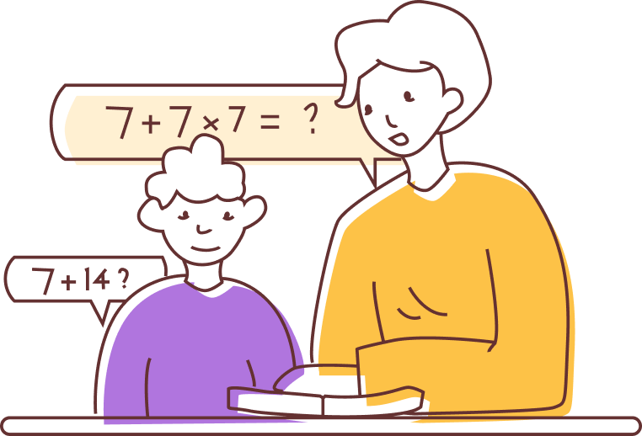
Background
Tutoring is one of the most effective instructional methods which can help student improve their learning achievements.
VanLehn, K. (2011). The relative effectiveness of human tutoring, intelligent tutoring systems, and other tutoring systems. Educational Psychologist, 46(4), 197-221.

Slide 3
Background
Challenge:
providing personalized tutoring dialogues for the large student cohorts

Slide 4
Background
An opportunity for the provision of dialogue tutoring
Dialogue-based Intelligent Tutoring System (ITS)
Litman, D., & Silliman, S. (2004). ITSPOKE: An intelligent tutoring spoken dialogue system. In Demonstration papers at HLT-NAACL 2004 (pp. 5-8).
Graesser, A. C., Lu, S., Jackson, G. T., Mitchell, H. H., Ventura, M., Olney, A., & Louwerse, M. M. (2004). AutoTutor: A tutor with dialogue in natural language. Behavior Research Methods, Instruments, & Computers, 36, 180-192.

Slide 5
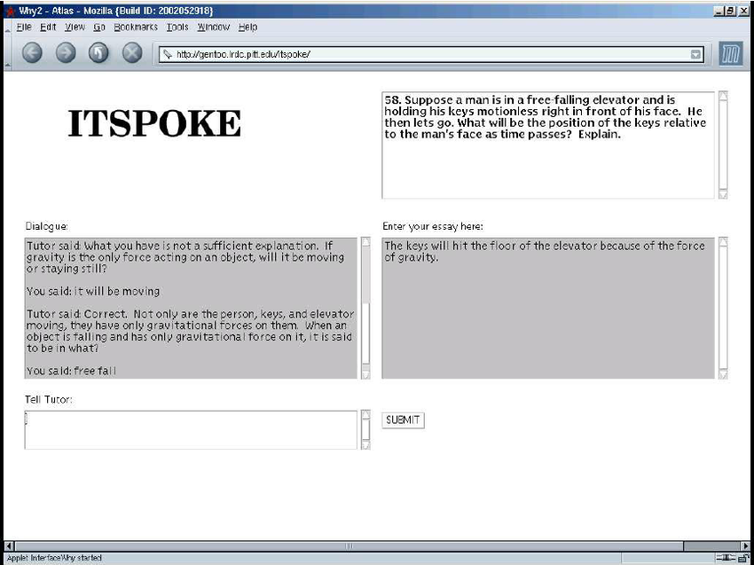
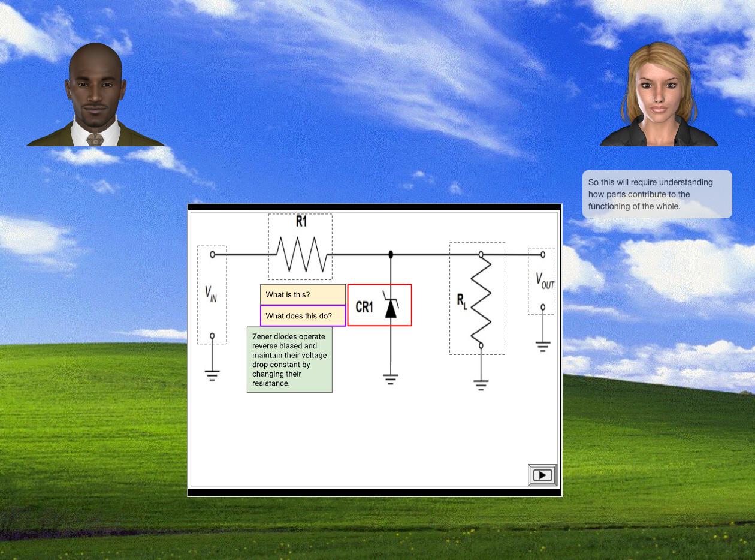
Background
Dialogue-based Intelligent Tutoring System (ITS)
ITSPOKE
AutoTutor
Litman, D., & Silliman, S. (2004). ITSPOKE: An intelligent tutoring spoken dialogue system. In Demonstration papers at HLT-NAACL 2004 (pp. 5-8).
Graesser, A. C., Lu, S., Jackson, G. T., Mitchell, H. H., Ventura, M., Olney, A., & Louwerse, M. M. (2004). AutoTutor: A tutor with dialogue in natural language. Behavior Research Methods, Instruments, & Computers, 36, 180-192.

Slide 6
Background
However, the dialogue-based ITSs still need to be improved to provide effective dialogue
Paladines, J., & Ramirez, J. (2020). A systematic literature review of intelligent tutoring systems with dialogue in natural language. IEEE Access, 8, 164246-164267.

Slide 7
Background
The use of the tutoring instructional strategies
Hints and negative feedback are two typical instructional strategies
Instructional strategy is defined as the approaches or principles employed by instructors to support students’ learning
Sottilare, R. A., DeFalco, J. A., & Connor, J. (2014). ‒A Guide to Instructional Techniques, Strategies and Tactics to Manage Learner Affect, Engagement, and Grit. Design recommendations for intelligent tutoring systems, 2, 7-33.

Slide 8
Background
Tutoring instructional strategies can be represented at the level of dialogue acts
Vail, A. K., & Boyer, K. E. (2014). Identifying effective moves in tutoring: On the refinement of dialogue act annotation schemes. Paper presented at the International conference on intelligent tutoring systems.

Slide 9
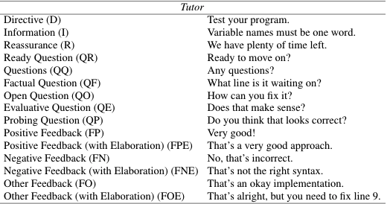
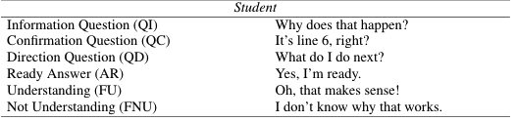
Background
Dialogue acts analyze the communicative intention in dialogue
Dialogue act scheme by Vail & Boyer (2014)
Vail, A. K., & Boyer, K. E. (2014). Identifying effective moves in tutoring: On the refinement of dialogue act annotation schemes. Paper presented at the International conference on intelligent tutoring systems.

Slide 10
Background
Using dialogue acts for tutoring dialogue analysis

Slide 11
What is the role of dialogue acts in dialogue tutoring?

Slide 12
Data
Yup Tutoring Dialogue Data (dataset for immediate feedback)
# Total tutorial sessions: 14,562
# Tutors: 116
# Students: 5,165 (K-12 level)
Student Performance
Gap-clarified (low performance, ineffective tutoring session)
Gap-explained (medium performance, less effective tutoring session)
Gap-bridged (high performance, effective tutoring session)

Slide 14
Dialogue Act Scheme
Dialogue acts analyze the communicative intention in dialogue
Dialogue act scheme by Vail & Boyer (2014)
Vail, A. K., & Boyer, K. E. (2014). Identifying effective moves in tutoring: On the refinement of dialogue act annotation schemes. Paper presented at the International conference on intelligent tutoring systems.

Slide 15
Dialogue Act Annotation
Tutor
Hint
Question
Student
Hint
Question
Positive Feedback

Slide 16
Student Prior Knowledge
Student prior progress (i.e., the progress that students made before joining the tutorial secessions) as the proxy of prior knowledge
Lin, J., Singh, S., Sha, L., Tan, W., Lang, D., Gašević, D., & Chen, G. (2022). Is it a good move? Mining effective tutoring strategies from human–human tutorial dialogues. Future Generation Computer Systems, 127, 194-207

Slide 17
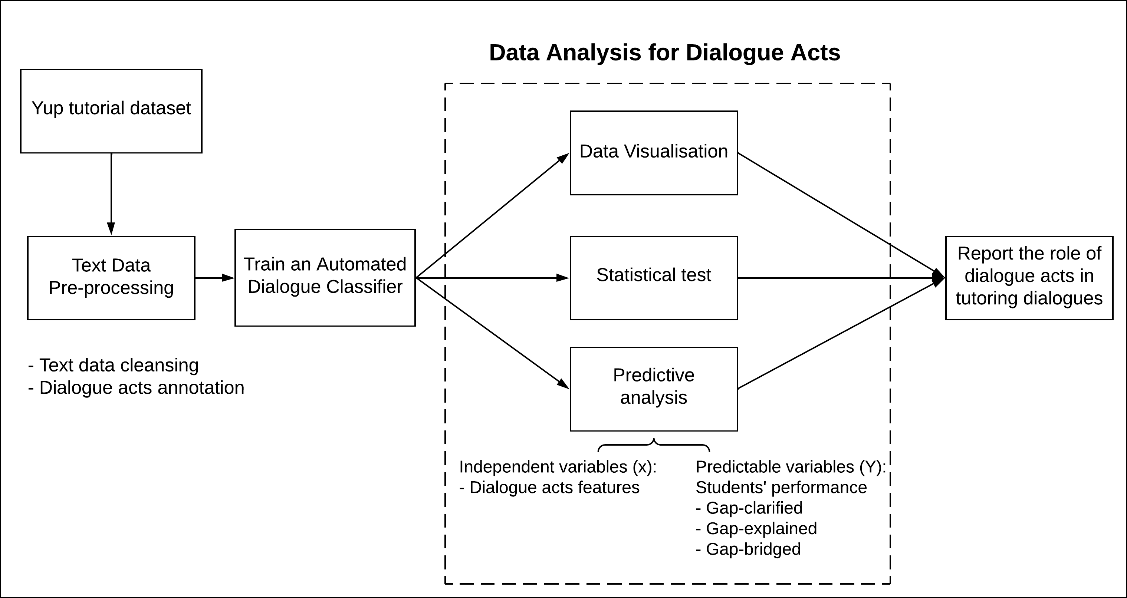

What is the role of dialogue acts in dialogue tutoring?
Lin, J., Singh, S., Sha, L., Tan, W., Lang, D., Gašević, D., & Chen, G. (2022). Is it a good move? Mining effective tutoring strategies from human–human tutorial dialogues. Future Generation Computer Systems, 127, 194-207

Slide 18
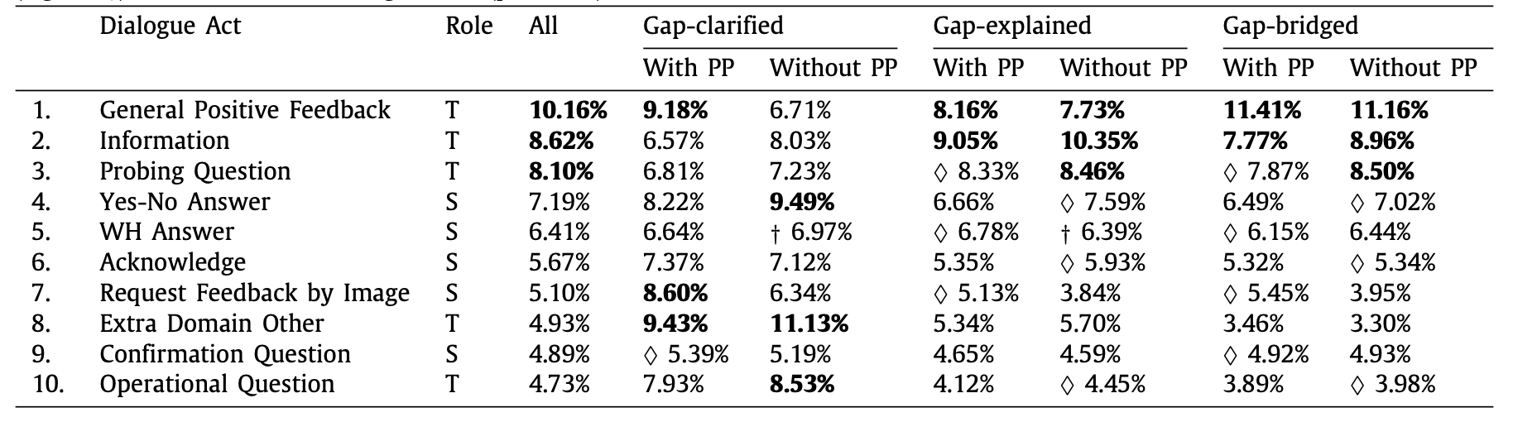
Findings
With PP: With Prior Progress Without PP: Without Prior Progress
Lin, J., Singh, S., Sha, L., Tan, W., Lang, D., Gašević, D., & Chen, G. (2022). Is it a good move? Mining effective tutoring strategies from human–human tutorial dialogues. Future Generation Computer Systems, 127, 194-207

Slide 19
Findings
Understanding the use of instructional strategies in tutoring
In effective tutorial sessions, tutors provided more hints, thought-provoking questions, and less off-topic statements to students
The students with prior progress received fewer hints and thought-provoking questions from a tutor compared to the students without prior progress.
Lin, J., Singh, S., Sha, L., Tan, W., Lang, D., Gašević, D., & Chen, G. (2022). Is it a good move? Mining effective tutoring strategies from human–human tutorial dialogues. Future Generation Computer Systems, 127, 194-207

Slide 20
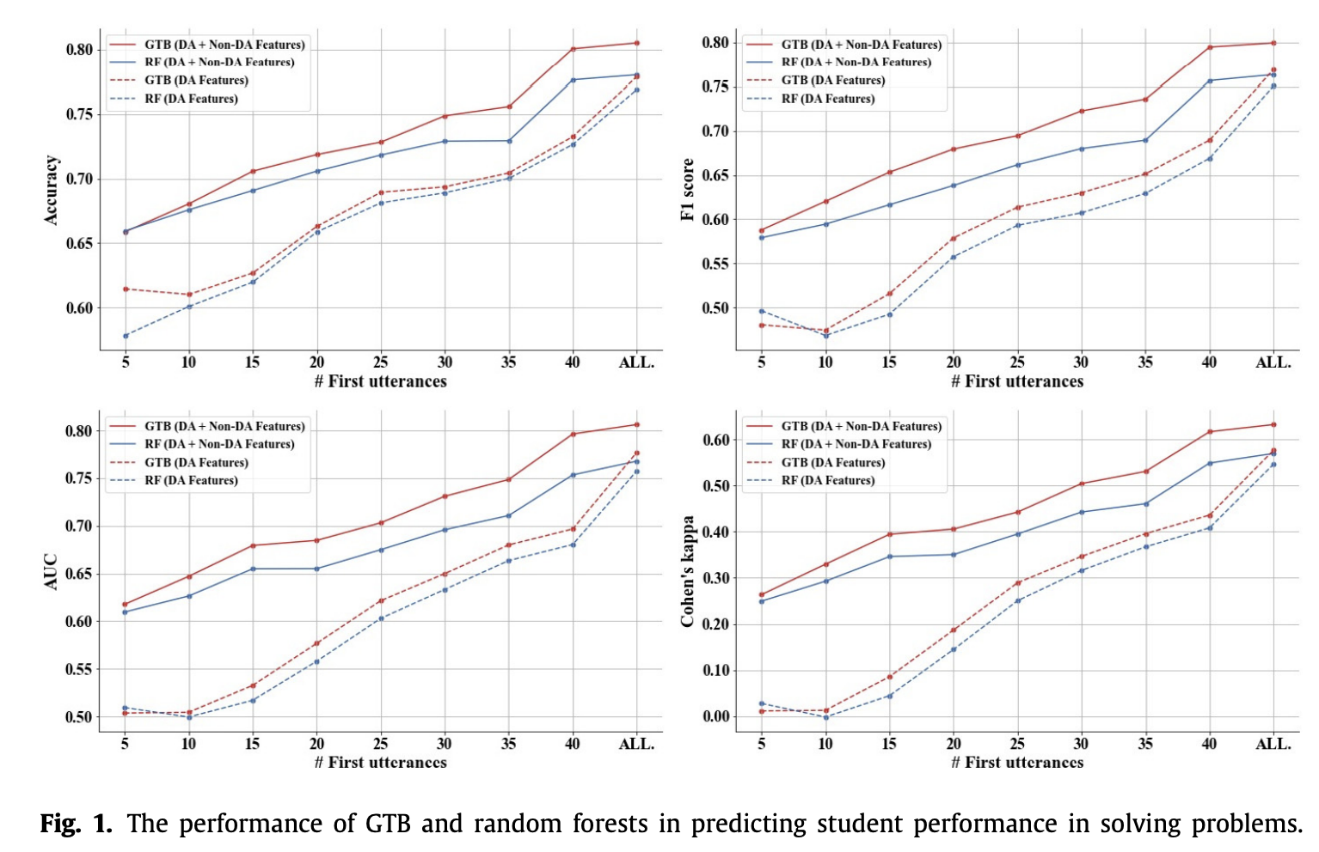
Findings - Predictive power of using dialogue acts
Lin, J., Singh, S., Sha, L., Tan, W., Lang, D., Gašević, D., & Chen, G. (2022). Is it a good move? Mining effective tutoring strategies from human–human tutorial dialogues. Future Generation Computer Systems, 127, 194-207

Slide 21
Findings
Predictive power of using dialogue acts
The use of dialogue acts (DAs) has the potential to predict students’ problem-solving performance.
Incorporating DAs with other factors (e.g., N-grams, sentiment contained in utterances) into the student performance prediction can enhance the prediction accuracy
Lin, J., Singh, S., Sha, L., Tan, W., Lang, D., Gašević, D., & Chen, G. (2022). Is it a good move? Mining effective tutoring strategies from human–human tutorial dialogues. Future Generation Computer Systems, 127, 194-207

Slide 22
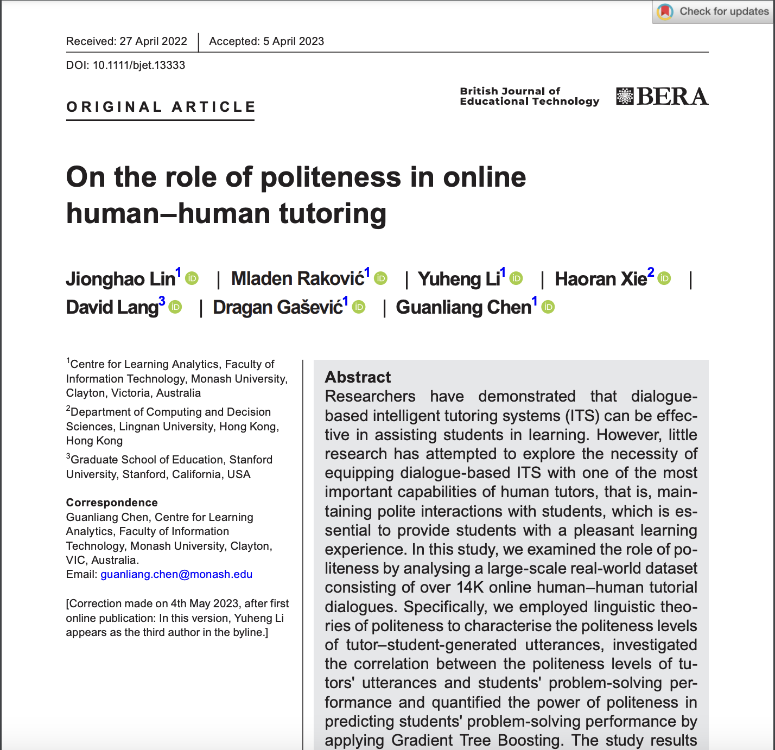
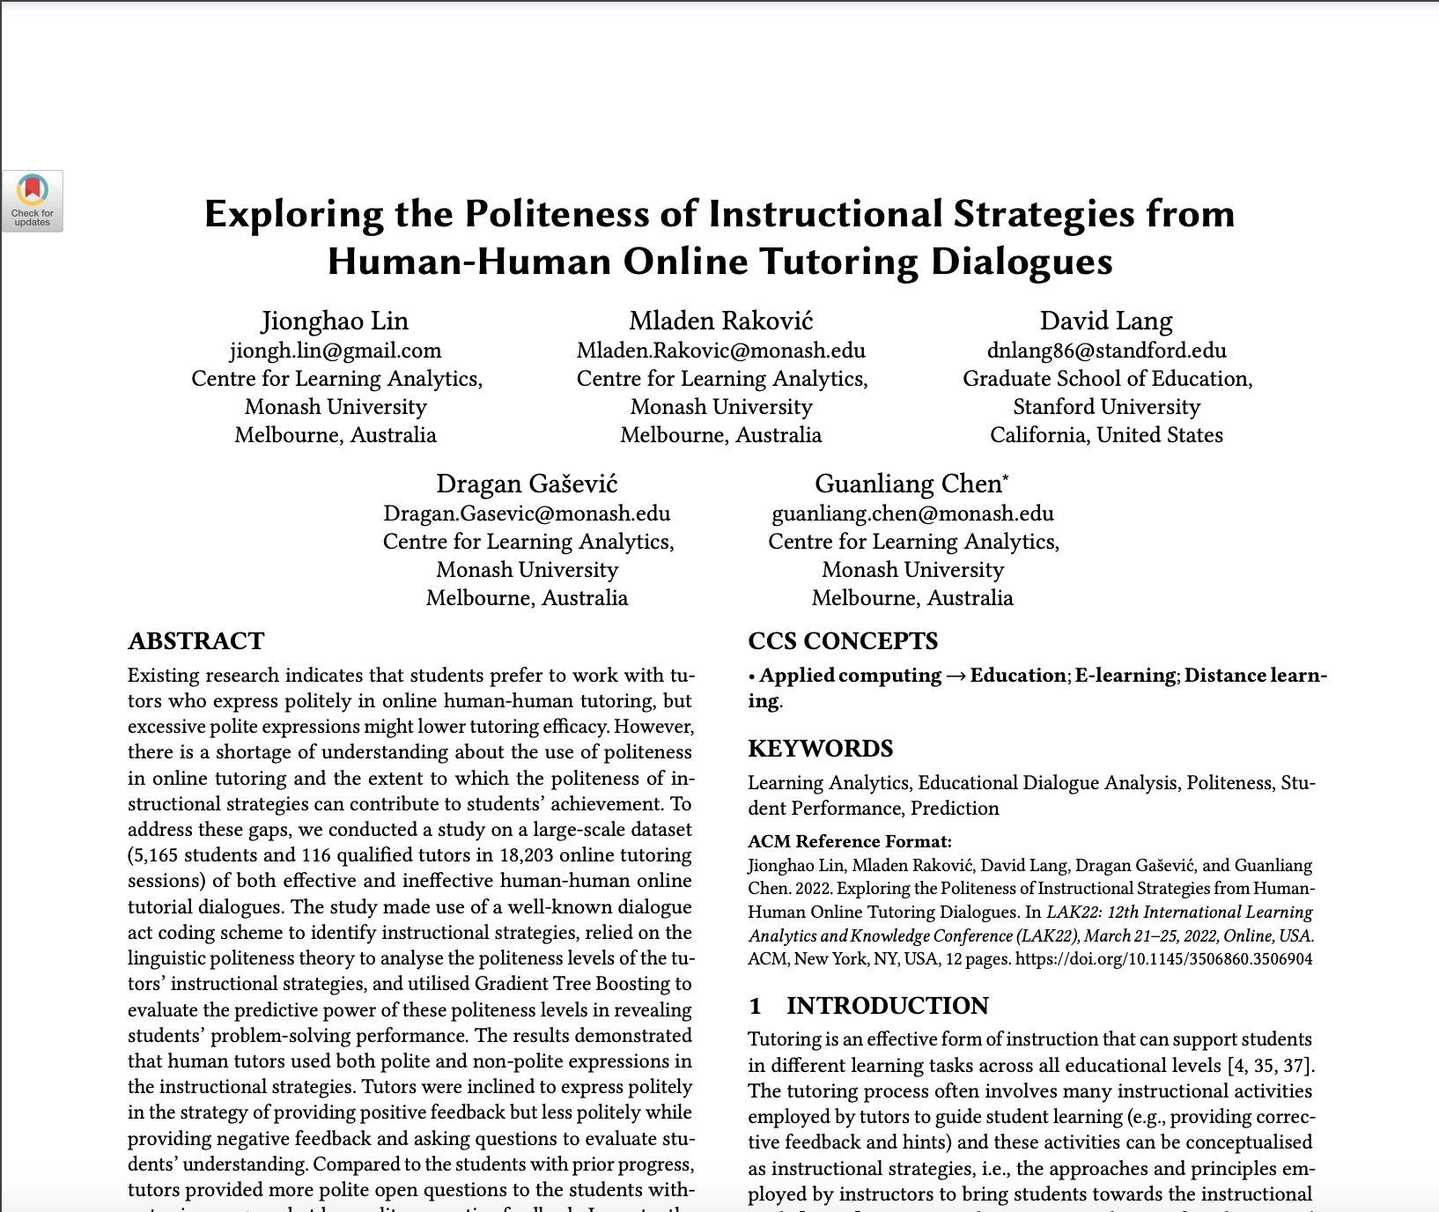
Other Findings about Tutoring Practice
Sentiment analysis/Analytics of linguistic politeness in the tutoring dialogues
Lin, J., Raković, M., Li, Y., Xie, H., Lang, D., Gašević, D., & Chen, G. (2023). On the role of politeness in online human–human tutoring. British Journal of Educational Technology.
Lin, J., Rakovic, M., Lang, D., Gasevic, D., & Chen, G. (2022, March). Exploring the politeness of instructional strategies from human-human online tutoring dialogues. In LAK22: 12th International Learning Analytics and Knowledge Conference (pp. 282-293).

Slide 23
Other Findings about Tutoring Practice
Sentiment analysis/Analytics of linguistic politeness in the tutoring dialogues
In effective tutorial sessions, tutors tended to be very polite at the start of a tutorial session and became more direct in guiding students as the session progressed.
Lin, J., Raković, M., Li, Y., Xie, H., Lang, D., Gašević, D., & Chen, G. (2023). On the role of politeness in online human–human tutoring. British Journal of Educational Technology.
Lin, J., Rakovic, M., Lang, D., Gasevic, D., & Chen, G. (2022, March). Exploring the politeness of instructional strategies from human-human online tutoring dialogues. In LAK22: 12th International Learning Analytics and Knowledge Conference (pp. 282-293).

Slide 24
Other Findings about Tutoring Practice
Sentiment analysis/Analytics of linguistic politeness in the tutoring dialogues
In effective tutorial sessions, tutors tended to be very polite at the start of a tutorial session and became more direct in guiding students as the session progressed.
Tutors from effective tutoring sessions communicate more politely when asking open-ended questions to students with less prior knowledge than those with higher prior knowledge.
Lin, J., Raković, M., Li, Y., Xie, H., Lang, D., Gašević, D., & Chen, G. (2023). On the role of politeness in online human–human tutoring. British Journal of Educational Technology.
Lin, J., Rakovic, M., Lang, D., Gasevic, D., & Chen, G. (2022, March). Exploring the politeness of instructional strategies from human-human online tutoring dialogues. In LAK22: 12th International Learning Analytics and Knowledge Conference (pp. 282-293).

Slide 25
Other Findings about Tutoring Practice
Sentiment analysis/Analytics of linguistic politeness in the tutoring dialogues
In effective tutorial sessions, tutors tended to be very polite at the start of a tutorial session and became more direct in guiding students as the session progressed.
Tutors from effective tutoring sessions communicate more politely when asking open-ended questions to students with less prior knowledge than those with higher prior knowledge.
Tutors can use non-polite expression for some strategies (e.g., negative feedback) as long as the instruction meets the students’ needs of solving problems
Lin, J., Raković, M., Li, Y., Xie, H., Lang, D., Gašević, D., & Chen, G. (2023). On the role of politeness in online human–human tutoring. British Journal of Educational Technology.
Lin, J., Rakovic, M., Lang, D., Gasevic, D., & Chen, G. (2022, March). Exploring the politeness of instructional strategies from human-human online tutoring dialogues. In LAK22: 12th International Learning Analytics and Knowledge Conference (pp. 282-293).

Slide 26
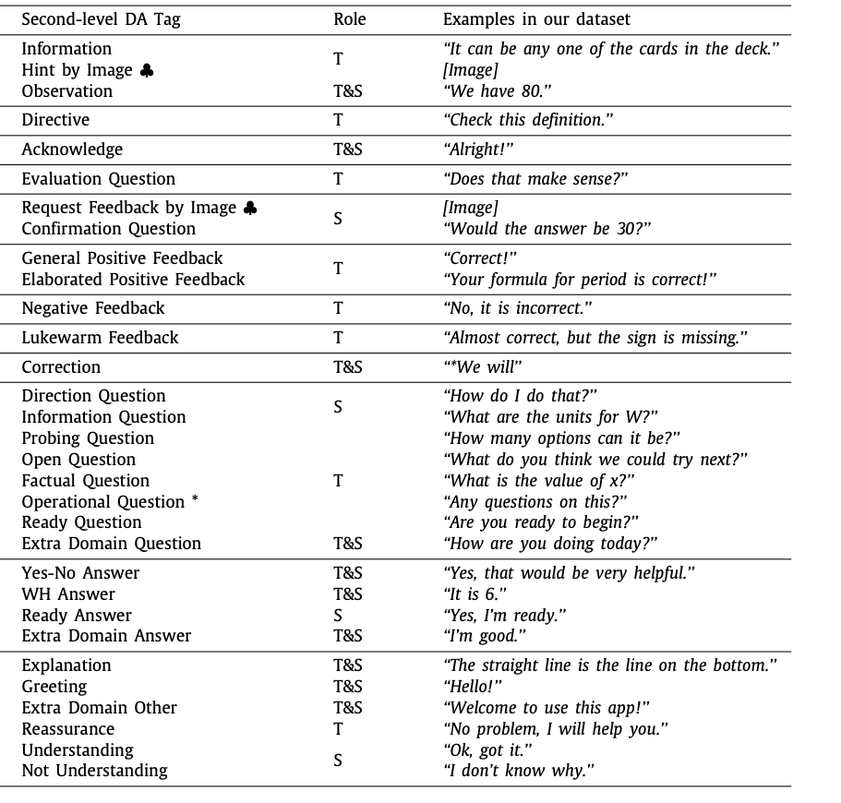
Challenges
Annotating the dialogue act is cost demanding and time-consuming
Rus, V., Maharjan, N., & Banjade, R. (2017). Dialogue act classification in human-to-human tutorial dialogues. In Innovations in smart learning (pp. 185-188). Springer, Singapore.

Slide 27
Challenges
Given a limited budget in terms of finances and human resources, does the training sample size adequately enable the model to correctly classify a certain label?

Slide 28
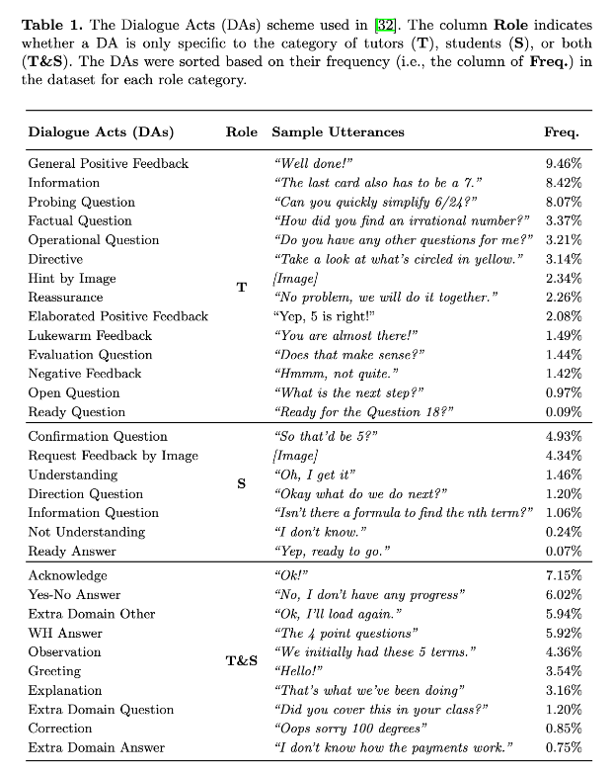
Challenges
In cases of limited sample sizes,

Slide 29
Challenges
In cases of limited sample sizes, how can we enhance classification performance within a low-resource setting?

Slide 30
Challenges
How robust is the dialogue act classifier in handling imbalanced data distributions?

Slide 31
Does the training sample size adequately enable the model to correctly classify a certain label?

Slide 32
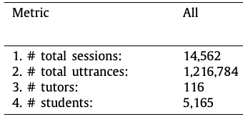
Background
With millions of tutoring utterances available, how will you annotate dialogue acts for these utterances?
Lin, J., Singh, S., Sha, L., Tan, W., Lang, D., Gašević, D., & Chen, G. (2022). Is it a good move? Mining effective tutoring strategies from human–human tutorial dialogues. Future Generation Computer Systems, 127, 194-207

Slide 33


Background
With millions of tutoring dialogues available, how will you annotate dialogue acts for these dialogues?
Dialogues
Hire
Annotate

Slide 34
Background
With millions of tutoring dialogues available, how will you annotate dialogue acts for these dialogues?
Dialogues
Random Sampling
Lin, J., Singh, S., Sha, L., Tan, W., Lang, D., Gašević, D., & Chen, G. (2022). Is it a good move? Mining effective tutoring strategies from human–human tutorial dialogues. Future Generation Computer Systems, 127, 194-207

Slide 35
(Frequency)
Background
The column Role indicates whether a DA is only specific to the category of tutors (T), students (S), or both (T&S).

Slide 36
Background
If we randomly select training samples from the whole dataset, does the training sample size adequately enable the model to correctly classify a certain label?

Slide 37
Background
Learnability is the capacity of a machine learning algorithm to accurately generalize and make predictions from a finite set of training data.
Swayamdipta, S., Schwartz, R., Lourie, N., Wang, Y., Hajishirzi, H., Smith, N. A., & Choi, Y. (2020, November). Dataset Cartography: Mapping and Diagnosing Datasets with Training Dynamics. In Proceedings of the 2020 Conference on Empirical Methods in Natural Language Processing (EMNLP) (pp. 9275-9293).

Slide 38
Background
Training samples can be categorized into easy to learn, medium to learn, hard to learn, and impossible to learn
Karamcheti, S., Krishna, R., Fei-Fei, L., & Manning, C. D. (2021, August). Mind Your Outliers! Investigating the Negative Impact of Outliers on Active Learning for Visual Question Answering. In Proceedings of the 59th Annual Meeting of the Association for Computational Linguistics and the 11th International Joint Conference on Natural Language Processing (Volume 1: Long Papers) (pp. 7265-7281).

Slide 39
Background
With millions of tutoring dialogues available, how will you annotate dialogue acts for these dialogues?
Dialogues
Random Sampling

Slide 40
Background
Distribution of Population data
Easy
Distribution of Sample data
60%
Random Sampling
Easy
60%
20%
Medium
Medium
20%
15%
Hard
Hard
15%
Impossible
5%
5%
Impossible
Swayamdipta, S., Schwartz, R., Lourie, N., Wang, Y., Hajishirzi, H., Smith, N. A., & Choi, Y. (2020, November). Dataset Cartography: Mapping and Diagnosing Datasets with Training Dynamics. In Proceedings of the 2020 Conference on Empirical Methods in Natural Language Processing (EMNLP) (pp. 9275-9293).

Slide 41
Research Method
- Dataset
Ethical approval from the Monash Human Research Ethics Committee (ID: 26156)
Randomly selected 50 tutorial dialogue sessions, 3,626 utterances (2,156 tutor utterances and 1,470 student utterances).

Slide 42
Data Maps
Data Maps is a model-specific tool to inform the difficulty level of machine learning models to learn from the training instances
Swayamdipta, S., Schwartz, R., Lourie, N., Wang, Y., Hajishirzi, H., Smith, N. A., & Choi, Y. (2020, November). Dataset Cartography: Mapping and Diagnosing Datasets with Training Dynamics. In Proceedings of the 2020 Conference on Empirical Methods in Natural Language Processing (EMNLP) (pp. 9275-9293).

Slide 43
Data Maps
Confidence is the mean probability from the classifier to a given label across the training epochs.
Variability is the variance in the model's probability estimates for a label across different epochs.
Correctness is the fraction of instances correctly classified by the classifier across the epochs.
Swayamdipta, S., Schwartz, R., Lourie, N., Wang, Y., Hajishirzi, H., Smith, N. A., & Choi, Y. (2020, November). Dataset Cartography: Mapping and Diagnosing Datasets with Training Dynamics. In Proceedings of the 2020 Conference on Empirical Methods in Natural Language Processing (EMNLP) (pp. 9275-9293).

Slide 44
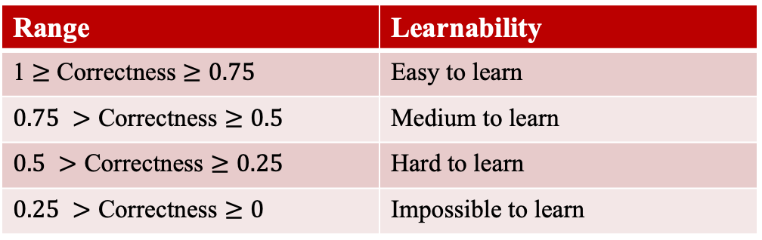
Data Maps
To interpret the learnability in categorical level, we categorized Correctness into four categories as suggested by a recent study (Karamcheti, 2021)
Range | Learnability
1 $≥$ Correctness $≥0.75$ | Easy to learn
$0.75 >\text{Correctness}≥0.5$ | Medium to learn
$0.5 >\text{Correctness}≥0.25$ | Hard to learn
$0.25 >\text{Correctness}≥0$ | Impossible to learn
Karamcheti, S., Krishna, R., Fei-Fei, L., & Manning, C. D. (2021, August). Mind Your Outliers! Investigating the Negative Impact of Outliers on Active Learning for Visual Question Answering. In Proceedings of the 59th Annual Meeting of the Association for Computational Linguistics and the 11th International Joint Conference on Natural Language Processing (Volume 1: Long Papers) (pp. 7265-7281).

Slide 45
Active Learning
Commonly-used sampling strategies in AIED
Random Baseline is a sampling strategy that samples the number of instances uniformly at random from the unlabeled pool (Settles, 2012).
Settles, B. 2012. Active Learning. Morgan & Claypool Publishers.
Yang, Y., & Loog, M. (2016, December). Active learning using uncertainty information. In 2016 23rd International Conference on Pattern Recognition (ICPR) (pp. 2646-2651). IEEE.
Tan, W., Du, L., & Buntine, W. (2021). Diversity enhanced active learning with strictly proper scoring rules. Advances in Neural Information Processing Systems, 34, 10906-10918.

Slide 46
Active Learning
Commonly-used sampling strategies in AIED
Random Baseline is a sampling strategy that samples the number of instances uniformly at random from the unlabeled pool (Settles, 2012).
Maximum Entropy is an uncertainty-based method that chooses the instances with the highest entropy scores of the predictive distribution from the unlabeled pool (Yang, 2016).
Settles, B. 2012. Active Learning. Morgan & Claypool Publishers.
Yang, Y., & Loog, M. (2016, December). Active learning using uncertainty information. In 2016 23rd International Conference on Pattern Recognition (ICPR) (pp. 2646-2651). IEEE.
Tan, W., Du, L., & Buntine, W. (2021). Diversity enhanced active learning with strictly proper scoring rules. Advances in Neural Information Processing Systems, 34, 10906-10918.

Slide 47
Active Learning
Commonly-used sampling strategies in AIED
Random Baseline is a sampling strategy that samples the number of instances uniformly at random from the unlabeled pool (Settles, 2012).
Maximum Entropy is an uncertainty-based method that chooses the instances with the highest entropy scores of the predictive distribution from the unlabeled pool (Yang, 2016).
Least Confidence is another uncertainty-based method that chooses the instances with the least confidence scores of the predictive distribution from the unlabeled pool (Burr, 2012).
Settles, B. 2012. Active Learning. Morgan & Claypool Publishers.
Yang, Y., & Loog, M. (2016, December). Active learning using uncertainty information. In 2016 23rd International Conference on Pattern Recognition (ICPR) (pp. 2646-2651). IEEE.
Tan, W., Du, L., & Buntine, W. (2021). Diversity enhanced active learning with strictly proper scoring rules. Advances in Neural Information Processing Systems, 34, 10906-10918.

Slide 48
Active Learning
Commonly-used sampling strategies in AIED
Random Baseline is a sampling strategy that samples the number of instances uniformly at random from the unlabeled pool (Settles, 2012).
Maximum Entropy is an uncertainty-based method that chooses the instances with the highest entropy scores of the predictive distribution from the unlabeled pool (Yang, 2016).
Least Confidence is another uncertainty-based method that chooses the instances with the least confidence scores of the predictive distribution from the unlabeled pool (Burr, 2012).
CoreMSE is a pool-based AL method proposed by Tan et al. (2021). The method involves both diversity and uncertainty measures via the sampling strategy
Settles, B. 2012. Active Learning. Morgan & Claypool Publishers.
Yang, Y., & Loog, M. (2016, December). Active learning using uncertainty information. In 2016 23rd International Conference on Pattern Recognition (ICPR) (pp. 2646-2651). IEEE.
Tan, W., Du, L., & Buntine, W. (2021). Diversity enhanced active learning with strictly proper scoring rules. Advances in Neural Information Processing Systems, 34, 10906-10918.

Slide 49
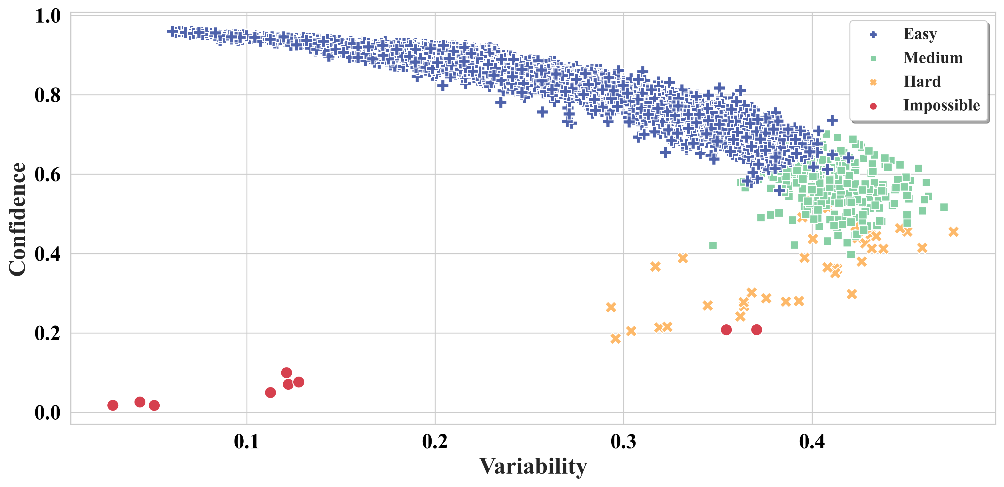
Data Map
Investigate the sample informativeness levels of annotated dialogue acts
Tan, W., Lin, J*., Lang, D., Chen, G., Gašević, D., Du, L., & Buntine, W. (2023). Does Informativeness Matter? Active Learning for Educational Dialogue Act Classification. International Conference on Artificial Intelligence in Education. Springer (2023)

Slide 50
Data Map
Investigate the sample informativeness levels of annotated dialogue acts
Tan, W., Lin, J*., Lang, D., Chen, G., Gašević, D., Du, L., & Buntine, W. (2023). Does Informativeness Matter? Active Learning for Educational Dialogue Act Classification. International Conference on Artificial Intelligence in Education. Springer (2023)

Slide 51
Data Map
Investigate the sample informativeness levels of annotated dialogue acts
Tan, W., Lin, J*., Lang, D., Chen, G., Gašević, D., Du, L., & Buntine, W. (2023). Does Informativeness Matter? Active Learning for Educational Dialogue Act Classification. International Conference on Artificial Intelligence in Education. Springer (2023)

Slide 52
Data Map
Investigate the sample informativeness levels of annotated dialogue acts
Tan, W., Lin, J*., Lang, D., Chen, G., Gašević, D., Du, L., & Buntine, W. (2023). Does Informativeness Matter? Active Learning for Educational Dialogue Act Classification. International Conference on Artificial Intelligence in Education. Springer (2023)

Slide 53
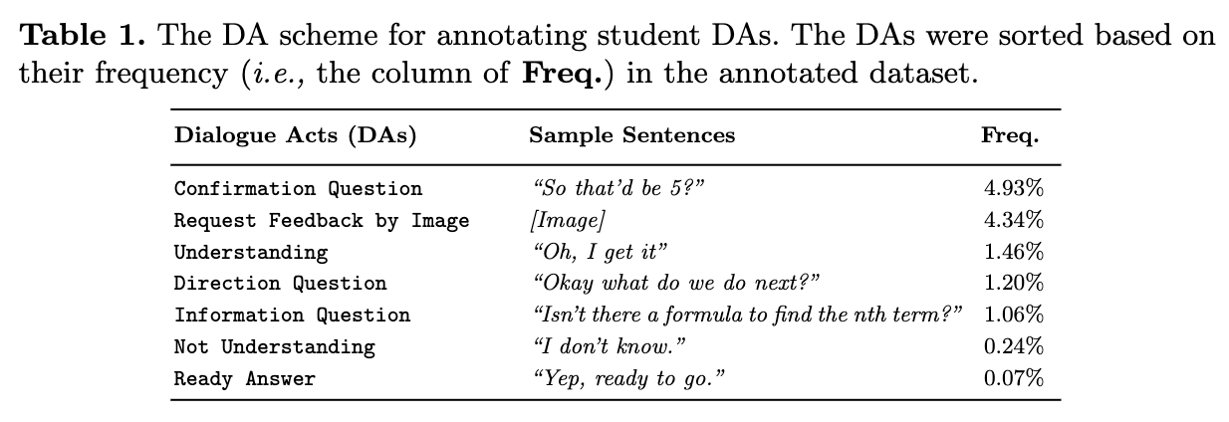
Dataset

Slide 54
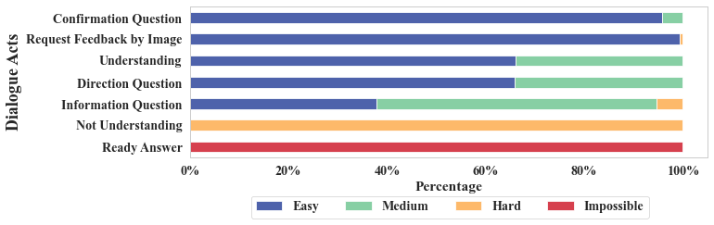
Results
Investigate the sample informativeness levels of annotated dialogue acts
Tan, W., Lin, J*., Lang, D., Chen, G., Gašević, D., Du, L., & Buntine, W. (2023). Does Informativeness Matter? Active Learning for Educational Dialogue Act Classification. International Conference on Artificial Intelligence in Education. Springer (2023)

Slide 55
Results
Investigate the sample informativeness levels of annotated dialogue acts
Confirmation Question – Easy
Request Feedback by Image – Easy
Understanding – Medium
Direction Question – Medium
Information Question – Medium
Not Understanding – Hard
Ready Answer - Impossible
Tan, W., Lin, J*., Lang, D., Chen, G., Gašević, D., Du, L., & Buntine, W. (2023). Does Informativeness Matter? Active Learning for Educational Dialogue Act Classification. International Conference on Artificial Intelligence in Education. Springer (2023)

Slide 56
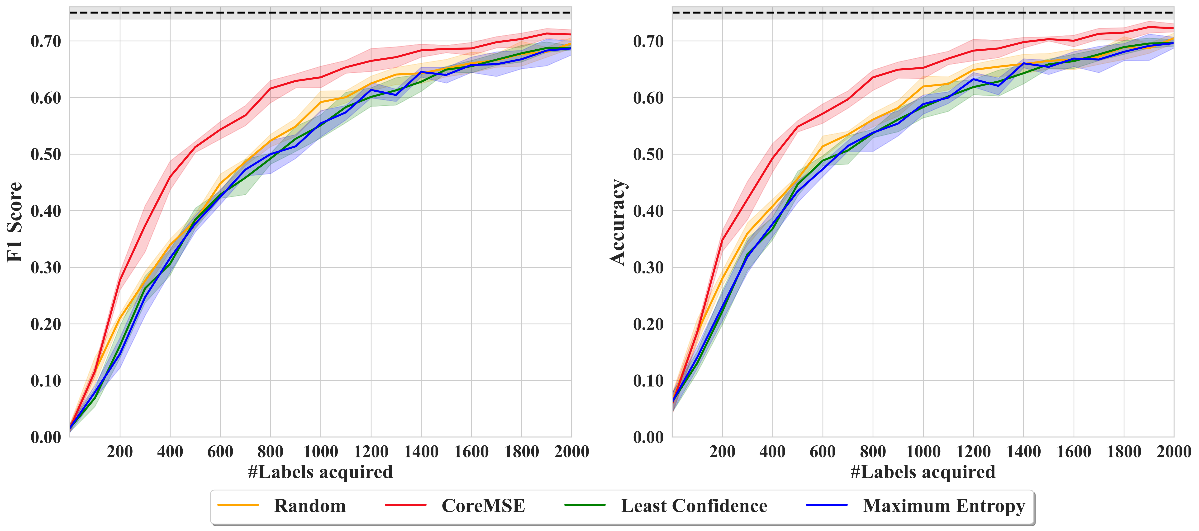
Results
Investigate the extent to which statistical AL methods support the classifier training on the dialogue acts with different informativeness levels.
Tan, W., Lin, J*., Lang, D., Chen, G., Gašević, D., Du, L., & Buntine, W. (2023). Does Informativeness Matter? Active Learning for Educational Dialogue Act Classification. International Conference on Artificial Intelligence in Education. Springer (2023)

Slide 57
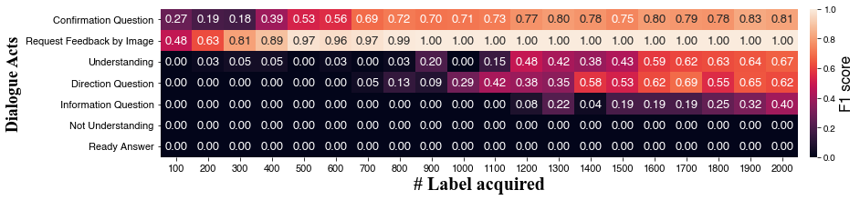
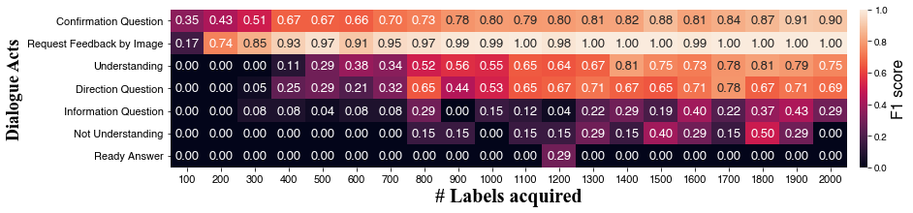
Confirmation Question – Easy Request Feedback by Image – Easy | Understanding – Medium Direction Question – Medium Information Question – Medium | Not Understanding – Hard Ready Answer - Impossible
Results
Random Sampling
CoreMSE
(Active Learning)
Tan, W., Lin, J*., Lang, D., Chen, G., Gašević, D., Du, L., & Buntine, W. (2023). Does Informativeness Matter? Active Learning for Educational Dialogue Act Classification. International Conference on Artificial Intelligence in Education. Springer (2023)

Slide 58
Confirmation Question – Easy Request Feedback by Image – Easy | Understanding – Medium Direction Question – Medium Information Question – Medium | Not Understanding – Hard Ready Answer - Impossible
Results
Random Sampling
CoreMSE
(Active Learning)
Tan, W., Lin, J*., Lang, D., Chen, G., Gašević, D., Du, L., & Buntine, W. (2023). Does Informativeness Matter? Active Learning for Educational Dialogue Act Classification. International Conference on Artificial Intelligence in Education. Springer (2023)

Slide 59
Confirmation Question – Easy Request Feedback by Image – Easy | Understanding – Medium Direction Question – Medium Information Question – Medium | Not Understanding – Hard Ready Answer - Impossible
Results
Random Sampling
CoreMSE
(Active Learning)
Tan, W., Lin, J*., Lang, D., Chen, G., Gašević, D., Du, L., & Buntine, W. (2023). Does Informativeness Matter? Active Learning for Educational Dialogue Act Classification. International Conference on Artificial Intelligence in Education. Springer (2023)

Slide 60
Confirmation Question – Easy Request Feedback by Image – Easy | Understanding – Medium Direction Question – Medium Information Question – Medium | Not Understanding – Hard Ready Answer - Impossible
Results
Random Sampling
CoreMSE
(Active Learning)
Tan, W., Lin, J*., Lang, D., Chen, G., Gašević, D., Du, L., & Buntine, W. (2023). Does Informativeness Matter? Active Learning for Educational Dialogue Act Classification. International Conference on Artificial Intelligence in Education. Springer (2023)

Slide 61
Confirmation Question – Easy Request Feedback by Image – Easy | Understanding – Medium Direction Question – Medium Information Question – Medium | Not Understanding – Hard Ready Answer - Impossible
Results
Random Sampling
CoreMSE
(Active Learning)
Tan, W., Lin, J*., Lang, D., Chen, G., Gašević, D., Du, L., & Buntine, W. (2023). Does Informativeness Matter? Active Learning for Educational Dialogue Act Classification. International Conference on Artificial Intelligence in Education. Springer (2023)

Slide 62
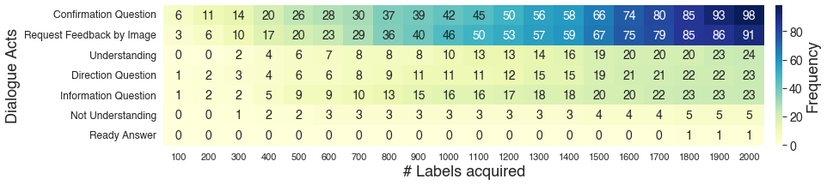
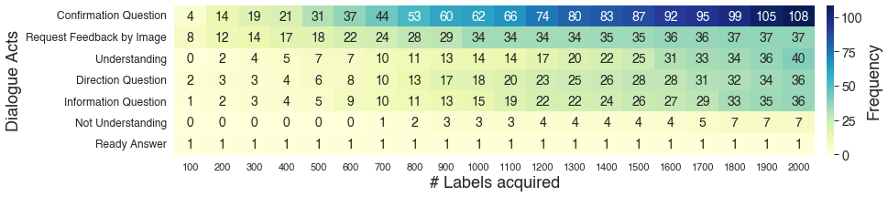
Confirmation Question – Easy Request Feedback by Image – Easy | Understanding – Medium Direction Question – Medium Information Question – Medium | Not Understanding – Hard Ready Answer - Impossible
Results
Random Sampling
CoreMSE
(Active Learning)
Tan, W., Lin, J*., Lang, D., Chen, G., Gašević, D., Du, L., & Buntine, W. (2023). Does Informativeness Matter? Active Learning for Educational Dialogue Act Classification. International Conference on Artificial Intelligence in Education. Springer (2023)

Slide 63
Confirmation Question – Easy Request Feedback by Image – Easy | Understanding – Medium Direction Question – Medium Information Question – Medium | Not Understanding – Hard Ready Answer - Impossible
Results
53 – 34 = 19
Annotate 19 extra instances by Random sampling!
Random Sampling
CoreMSE
(Active Learning)
Tan, W., Lin, J*., Lang, D., Chen, G., Gašević, D., Du, L., & Buntine, W. (2023). Does Informativeness Matter? Active Learning for Educational Dialogue Act Classification. International Conference on Artificial Intelligence in Education. Springer (2023)

Slide 64
Confirmation Question – Easy Request Feedback by Image – Easy | Understanding – Medium Direction Question – Medium Information Question – Medium | Not Understanding – Hard Ready Answer - Impossible
Results
Random Sampling
CoreMSE
(Active Learning)
Tan, W., Lin, J*., Lang, D., Chen, G., Gašević, D., Du, L., & Buntine, W. (2023). Does Informativeness Matter? Active Learning for Educational Dialogue Act Classification. International Conference on Artificial Intelligence in Education. Springer (2023)

Slide 65
Confirmation Question – Easy Request Feedback by Image – Easy | Understanding – Medium Direction Question – Medium Information Question – Medium | Not Understanding – Hard Ready Answer - Impossible
Results
Random Sampling
CoreMSE
(Active Learning)
Tan, W., Lin, J*., Lang, D., Chen, G., Gašević, D., Du, L., & Buntine, W. (2023). Does Informativeness Matter? Active Learning for Educational Dialogue Act Classification. International Conference on Artificial Intelligence in Education. Springer (2023)

Slide 66
Confirmation Question – Easy Request Feedback by Image – Easy | Understanding – Medium Direction Question – Medium Information Question – Medium | Not Understanding – Hard Ready Answer - Impossible
Results
Random Sampling
CoreMSE
(Active Learning)
Tan, W., Lin, J*., Lang, D., Chen, G., Gašević, D., Du, L., & Buntine, W. (2023). Does Informativeness Matter? Active Learning for Educational Dialogue Act Classification. International Conference on Artificial Intelligence in Education. Springer (2023)

Slide 67
Confirmation Question – Easy Request Feedback by Image – Easy | Understanding – Medium Direction Question – Medium Information Question – Medium | Not Understanding – Hard Ready Answer - Impossible
Results
Random Sampling
CoreMSE
(Active Learning)
Tan, W., Lin, J*., Lang, D., Chen, G., Gašević, D., Du, L., & Buntine, W. (2023). Does Informativeness Matter? Active Learning for Educational Dialogue Act Classification. International Conference on Artificial Intelligence in Education. Springer (2023)

Slide 68
Findings
Machine learning model can achieve satisfied classification performance on some labels (e.g., Request feedback by image) by a small amount of annotated data. Thus, if we can stop annotating the samples where achieve satisfied classification performance, we can save the cost of annotation
Tan, W., Lin, J*., Lang, D., Chen, G., Gašević, D., Du, L., & Buntine, W. (2023). Does Informativeness Matter? Active Learning for Educational Dialogue Act Classification. International Conference on Artificial Intelligence in Education. Springer (2023)

Slide 69
Research Motivation
- Low-resourced data
Due to the complexity of annotation, the dataset is often quite limited for training the dialogue act classifier.
Lin, J., Singh, S., Sha, L., Tan, W., Lang, D., Gašević, D., & Chen, G. (2022). Is it a good move? Mining effective tutoring strategies from human–human tutorial dialogues. Future Generation Computer Systems, 127, 194-207
Lin, J., Tan, W., Du, L., Buntine, W., Lang, D., Gašević, D., & Chen, G. (2023). Enhancing educational dialogue act classification with discourse context and sample informativeness. IEEE Transactions on Learning Technologies.

Slide 70
Research Motivation
- Imbalanced distribution
Many labels presented low percentage in the data distribution
For example, in the dataset in Samei et al., (2015), 23.9% sentences were labeled as Expressive (e.g., “Got it”) while 0.3% labeled as Hint (e.g., “Use triangle rules”).
Samei, B., Rus, V., Nye, B., Morrison, D.M.: Hierarchical dialogue act classification in online tutoring sessions. In: EDM. pp. 600–601 (2015)

Slide 71
Research Motivation
With the intent to improve the performance of the dialogue act classifier, we aim to explore approaches on enhancing:
the classification performance of a dialogue act classifier under the low-resourced scenario
the robustness of the dialogue act classifier on the highly-imbalanced data distribution.

Slide 72
How can we enhance the performance of a dialogue act classifier in low-resource and imbalanced data?

Slide 73
Research Methods
- Optimization Approaches
Cross Entropy (CE): commonly used loss function to optimize the classifier by comparing the predicted probability distribution to the true probability distribution (Baseline approach)
Yuan, Z., Yan, Y., Sonka, M., & Yang, T. (2021). Large-scale robust deep auc maximization: A new surrogate loss and empirical studies on medical image classification. In Proceedings of the IEEE/CVF International Conference on Computer Vision (pp. 3040-3049).
Yuan, Z., Guo, Z., Chawla, N., & Yang, T. (2021, October). Compositional training for end-to-end deep AUC maximization. In International Conference on Learning Representations.

Slide 74
Research Methods
- Optimization Approaches
Cross Entropy (CE): commonly used loss function to optimize the classifier by comparing the predicted probability distribution to the true probability distribution (Baseline approach)
Deep AUC maximization (DAM): optimize the performance of the dialogue act classifier by the AUC surrogate loss function (Yuan et al., 2020).
Yuan, Z., Yan, Y., Sonka, M., & Yang, T. (2021). Large-scale robust deep auc maximization: A new surrogate loss and empirical studies on medical image classification. In Proceedings of the IEEE/CVF International Conference on Computer Vision (pp. 3040-3049).
Yuan, Z., Guo, Z., Chawla, N., & Yang, T. (2021, October). Compositional training for end-to-end deep AUC maximization. In International Conference on Learning Representations.

Slide 75
Research Methods
- Optimization Approaches
Cross Entropy (CE): commonly used loss function to optimize the classifier by comparing the predicted probability distribution to the true probability distribution (Baseline approach)
Deep AUC maximization (DAM): optimize the performance of the dialogue act classifier by the AUC surrogate loss function (Yuan et al., 2020).
Compositional AUC (COMAUC): minimize a compositional objective function by alternating between maximizing the AUC score and minimizing the cross-entropy loss (Yuan et al., 2022).
Yuan, Z., Yan, Y., Sonka, M., & Yang, T. (2021). Large-scale robust deep auc maximization: A new surrogate loss and empirical studies on medical image classification. In Proceedings of the IEEE/CVF International Conference on Computer Vision (pp. 3040-3049).
Yuan, Z., Guo, Z., Chawla, N., & Yang, T. (2021, October). Compositional training for end-to-end deep AUC maximization. In International Conference on Learning Representations.

Slide 76
Research Methods
- Low-resource Scenario
We simulated the experiments under the low-resource setting with a training set size of {25, 50, 100, 200, 400, 800} randomly sampled from the full training set

Slide 77
Research Methods
- Imbalanced Scenario
Two settings of imbalanced data distribution:

Slide 78
Research Methods
- Imbalanced Scenario
Two settings of imbalanced data distribution:
First, we simulated imbalanced data distribution at different levels in the training set

Slide 79
Research Methods
- Imbalanced Scenario
Two settings of imbalanced data distribution:
First, we simulated imbalanced data distribution at different levels in the training set
Second, we simulated the imbalanced data distribution on both training and testing sets.

Slide 80
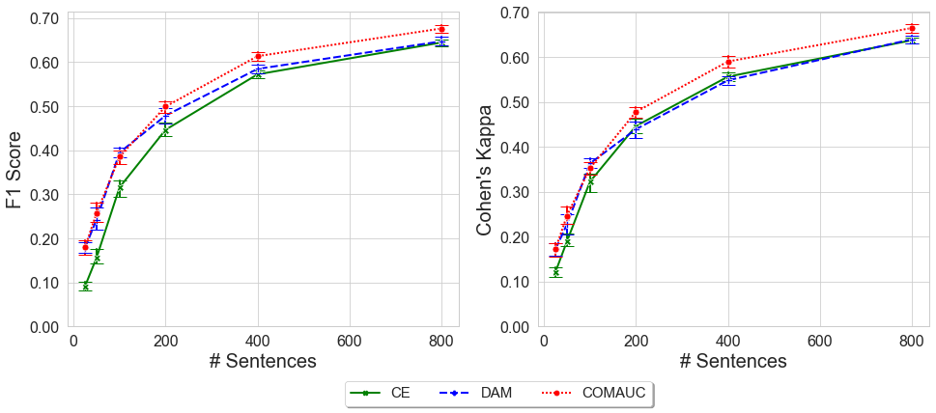
Results
- Low-resource Scenario
Cross Entropy (CE)
Deep AUC maximization (DAM)
Compositional AUC (COMAUC)
Fig. 2. Performance of DA classifiers with different optimization approaches

Slide 81
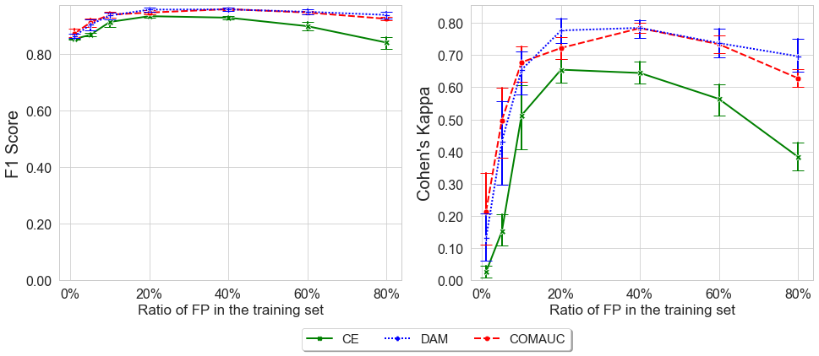
Results
- Imbalanced Scenario
Cross Entropy (CE)
Deep AUC maximization (DAM)
Compositional AUC (COMAUC)
Fig. 3. Classification performance on FP class with different optimization approaches to the data shift in training se

Slide 82
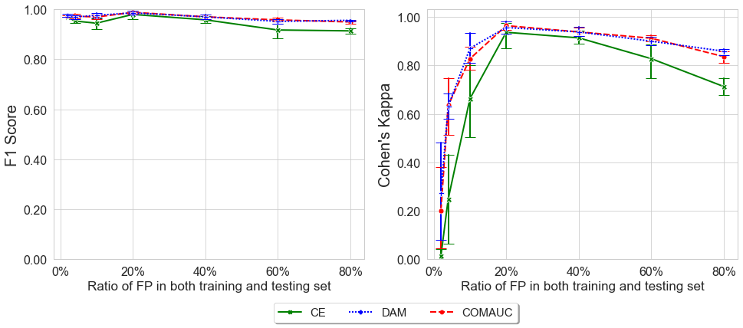
Results
- Imbalanced Scenario
Cross Entropy (CE)
Deep AUC maximization (DAM)
Compositional AUC (COMAUC)
Fig. 4. Classification performance on FP class with different optimization approaches to the data shift in both training and testing set

Slide 83
Conclusions
Classification is a significant task in applying artificial intelligence to the education domain.
Many educational classification tasks often encounter challenges of low-resource and imbalanced data distribution:
Predict at-risk students from LMS: Al-Luhaybi et al. (2019)
Feedback type classification: Cavalcanti et al. (2020)
Classification on classroom conversation: Zhao et al. (2023)
The classifiers might overfit the majority class of the dataset !

Slide 84
Main Takeaways
Data Collection
Random sampling
Active learning - CoreMSE …
…
Before building model
Data augmentation (*In progress) - Synonym replacement - LLM text generation …
Resampling - Oversampling (e.g., SMOTE) - Undersampling …
…
Building model
Default loss function: Cross Entropy
Modified loss function: AUC Maximization …
Few-shot learning
…

Slide 85
Impacts: AI in Education
Data Collection
Random sampling
Active learning - CoreMSE …
…
Building an educational dialogue act classifier
Large amount of unlabeled data but limited budget
Tan, W., Lin, J., Lang, D., Chen, G., Gašević, D., Du, L., & Buntine, W. (2023, June). Does informativeness matter? Active learning for educational dialogue act classification. In International Conference on Artificial Intelligence in Education (pp. 176-188). Cham: Springer Nature Switzerland.

Slide 86
Impacts: AI in Education
Before building model
Data Augmentation - Synonym replacement - LLM text generation …
Resampling - Oversampling (e.g., SMOTE) - Undersampling …
…
Identifying desired argumentative writing
limited amount of revised/annotated data, not suitable to experiment with various state-of-the-art deep learning models.
Afrin, T., & Litman, D. (2023, May). Predicting Desirable Revisions of Evidence and Reasoning in Argumentative Writing. In Findings of the Association for Computational Linguistics: EACL 2023 (pp. 2505-2516).

Slide 87
Impacts: AI in Education
Building model
Default loss function: Cross Entropy
Modified loss function: AUC Maximization …
Few-shot learning
…
Predicting student academic performance.
The number of students who are at high risk of failing was much less than the students who can pass.
Al-Luhaybi, M., Yousefi, L., Swift, S., Counsell, S., & Tucker, A. (2019). Predicting academic performance: a bootstrapping approach for learning dynamic bayesian networks. In Artificial Intelligence in Education: 20th International Conference, AIED 2019, Chicago, IL, USA, June 25-29, 2019, Proceedings, Part I 20 (pp. 26-36). Springer International Publishing.

Slide 88

Name: Jionghao Lin
Email: Jionghao@cmu.edu
Affiliation: Human Computer Interaction Institution (HCII), Carnegie Mellon University

